Slide 1


Welcome to Birdle – the game that makes time flyby!
Sometimes

Slide 2
Elevator Pitch
Concept
Process
Demonstration
Directions
Link

Slide 3

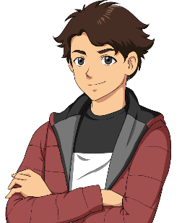






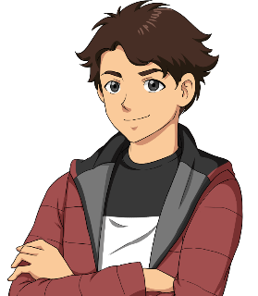
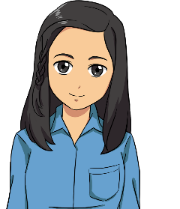


Intro slide 1
Welcome to Birdle – A little game to help time fly by!
Elevator Pitch
I get so bored waiting and I am tired of TikTok.
HaHa! Me too. I want to do more than just scroll.
I heard about a cool new game called Birdle.

Slide 4

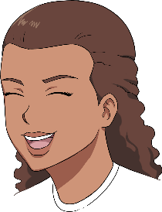
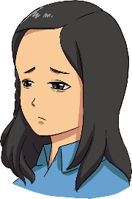
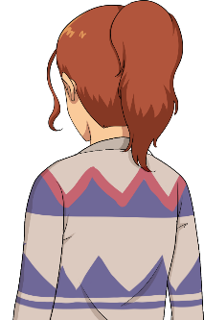
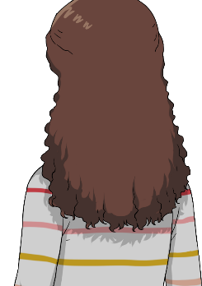

Example slide 4
Whoa. I have an idea for a comic. I should make one...
HaHa! Me too. I want to do more than just scroll.
HaHa! Me too. I want to do more than just scroll.

Slide 5
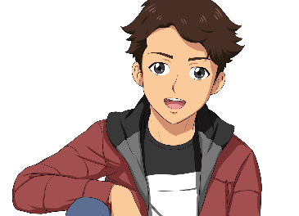
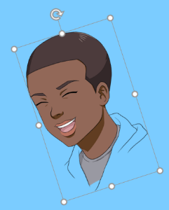

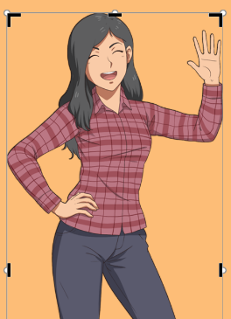

Intro slide 2
Here’s how to rotate and crop!
Rotate the character!
Click the object that you want to rotate.
Click the rotation handle at the top of the object, and then drag in the direction that you want.
There’s a lot more you can do. Just select a character and you’ll see everything you can do under the Format tab.
Crop the character!
On your slide, right-click the character, and then select Crop.

Slide 6

Intro slide 1
Welcome to Birdle – A little game to help time fly by!
Concept
I get so bored waiting and I am tired of TikTok.
HaHa! Me too. I want to do more than just scroll.
I heard about a cool new game called Birdle.

Slide 7
Intro slide 1
Welcome to Birdle – A little game to help time fly by!
Process
I get so bored waiting and I am tired of TikTok.
HaHa! Me too. I want to do more than just scroll.
I heard about a cool new game called Birdle.

Slide 8
Intro slide 1
Welcome to Birdle – A little game to help time fly by!
Demo
I get so bored waiting and I am tired of TikTok.
HaHa! Me too. I want to do more than just scroll.
I heard about a cool new game called Birdle.

Slide 9
Intro slide 1
Welcome to Birdle – A little game to help time fly by!
Directions
I get so bored waiting and I am tired of TikTok.
HaHa! Me too. I want to do more than just scroll.
I heard about a cool new game called Birdle.

Slide 10
Intro slide 1
Welcome to Birdle – A little game to help time fly by!
Links
I get so bored waiting and I am tired of TikTok.
HaHa! Me too. I want to do more than just scroll.
I heard about a cool new game called Birdle.

Slide 12


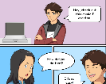



Intro slide 3
That's so cool. You should post your comic online.
100,000
Whoa. I have an idea for a comic. I should make one...
and so should you!

Slide 13
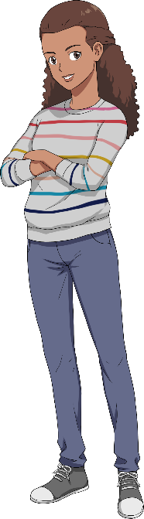

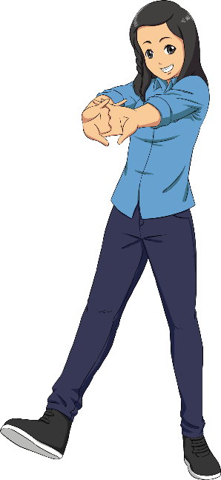

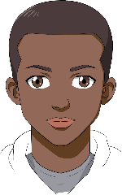
Example slide 1
Combine characters into scenes, and crop, flip, or resize the pictures to get just the expressions you want. Start with these layouts or make your own!

Slide 14
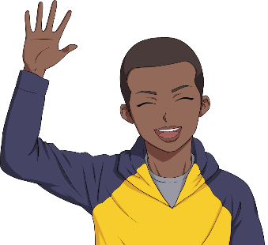
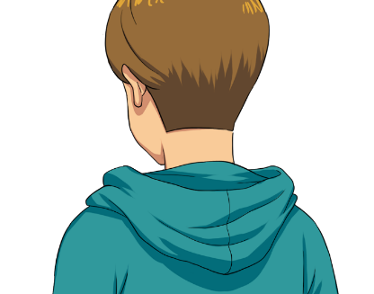
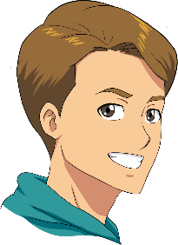
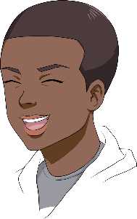
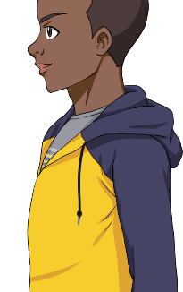
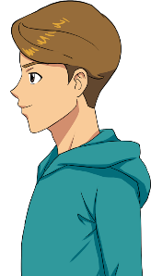
Example slide 2

Slide 15
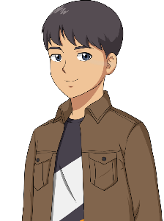
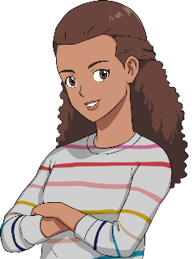
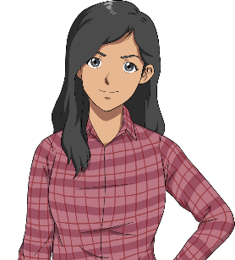

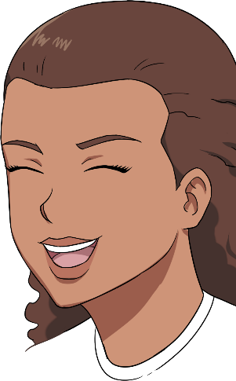
Example slide 3

Slide 16
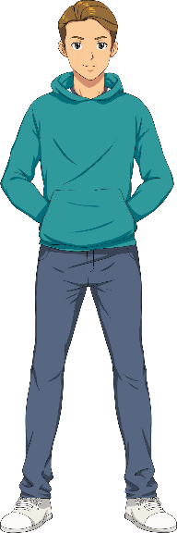
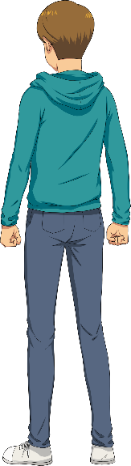

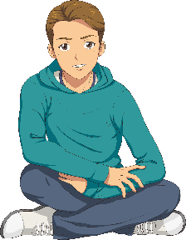


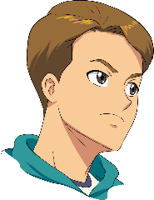
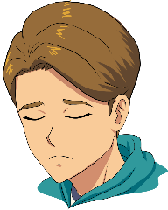
People slide 1

Slide 17
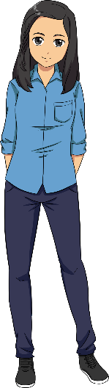





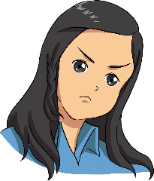

People slide 2

Slide 18
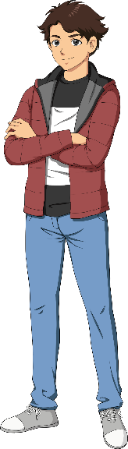
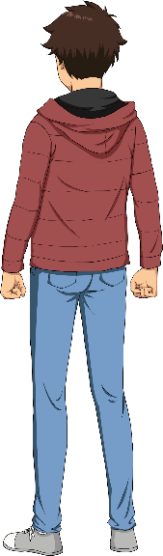

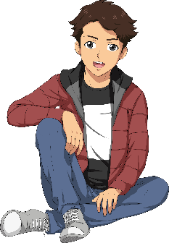



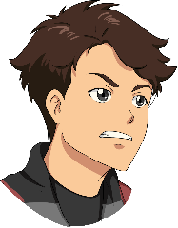
People slide 3

Slide 19





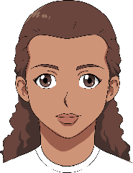
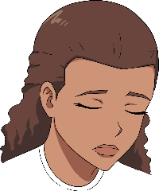
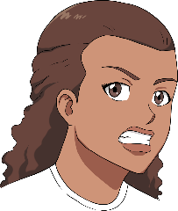
People slide 4

Slide 20
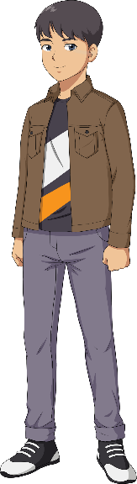
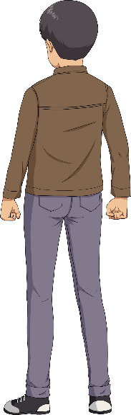





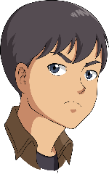
People slide 5

Slide 21
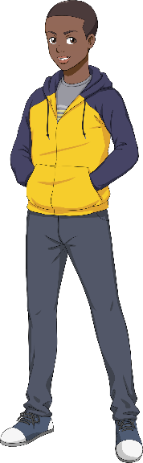




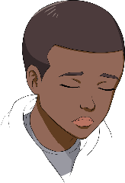
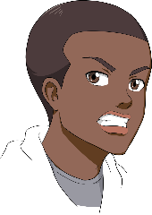
People slide 6

Slide 22

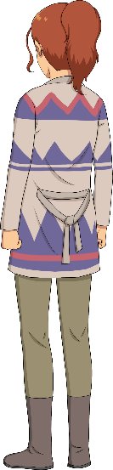

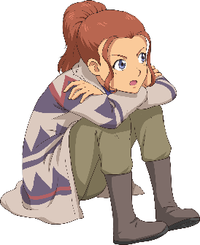


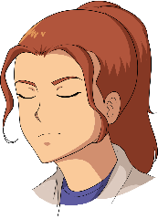
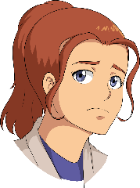
People slide 7

Slide 23
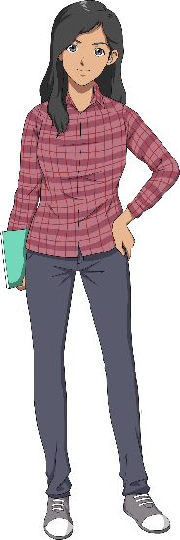


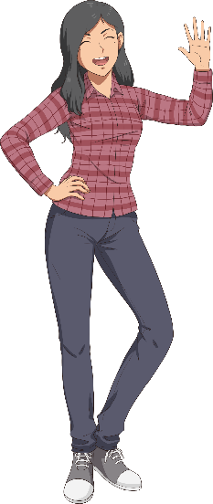




People slide 8

